Slide 1
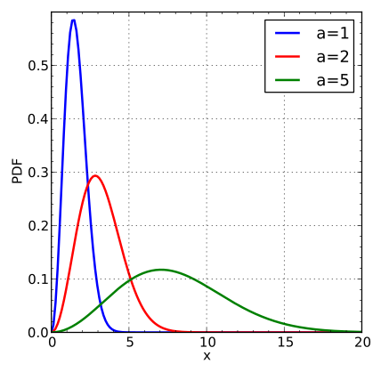
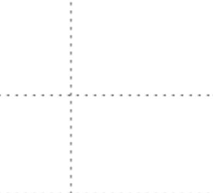
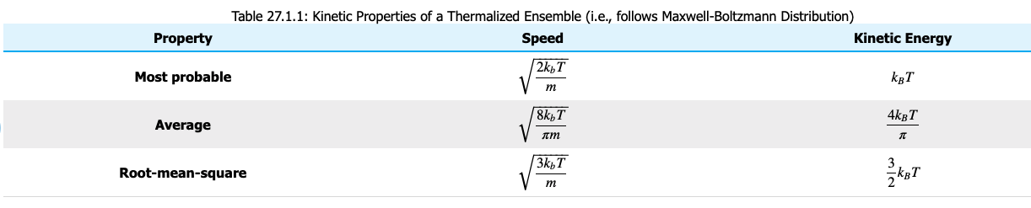


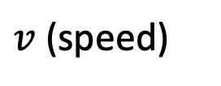



Recap of the averages
$$f_{M}$$
$$c^{∗}$$
$$\overline{c}= <v>$$
$$c= <v^{2}>^{1/2}$$
Write down these results
Next we’ll apply them to a problem
Then we’ll derive them
$v$ (speed)
$c^{∗}<\overline{c}<c$

Slide 2
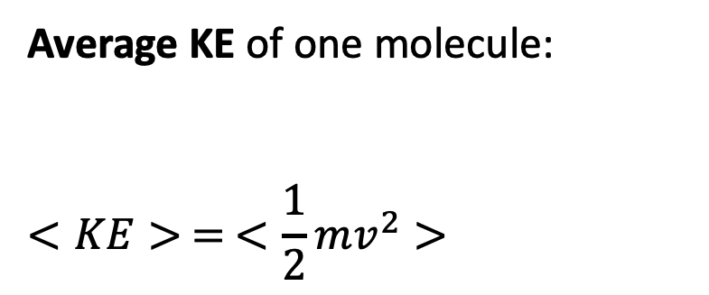
Average kinetic energy
Average KE of one molecule:
$$<KE> = <\frac{1}{2}mv^{2}>$$

Slide 3
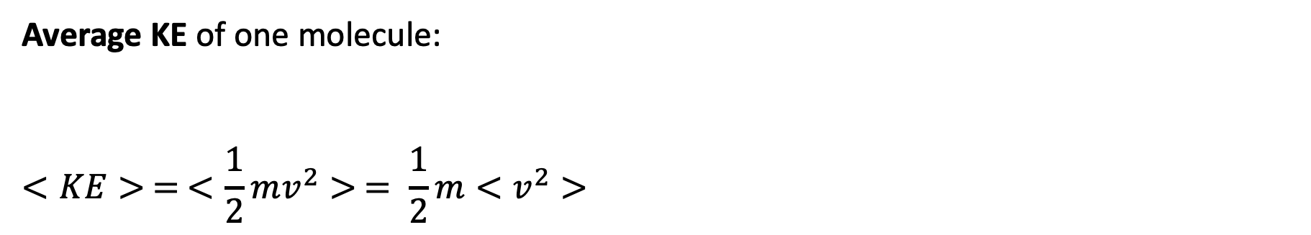
Average kinetic energy
Average KE of one molecule:
$$<KE> = <\frac{1}{2}mv^{2}> = \frac{1}{2}m<v^{2}>$$

Slide 4
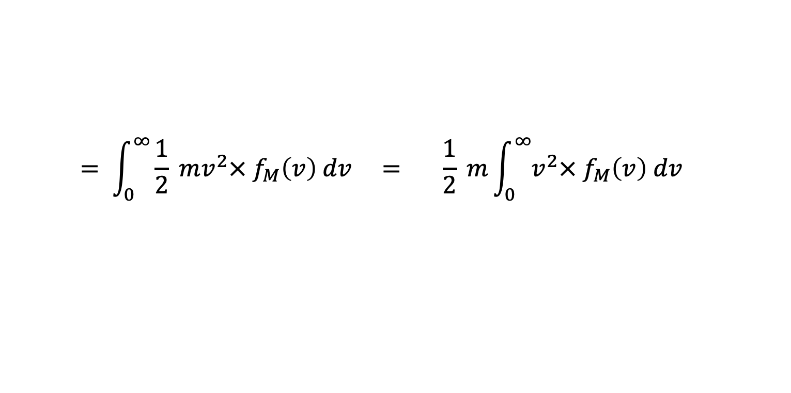
Average kinetic energy
Average KE of one molecule:
$$<KE> = <\frac{1}{2}mv^{2}> = \frac{1}{2}m<v^{2}>$$
$$= \int_{0}^{∞}{\frac{1}{2} mv^{2}× f_{M}\left(v\right) dv} = \frac{1}{2} m\int_{0}^{∞}{v^{2}× f_{M}\left(v\right) dv}$$

Slide 5
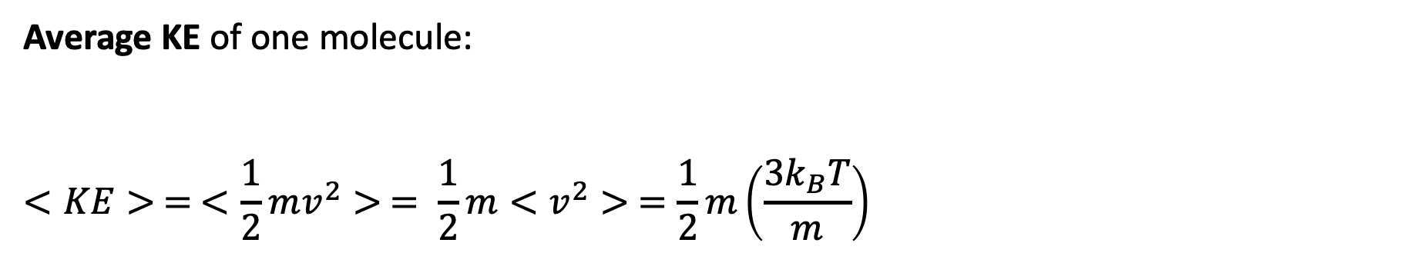
Average kinetic energy
Average KE of one molecule:
$$<KE> = <\frac{1}{2}mv^{2}> = \frac{1}{2}m<v^{2}> =\frac{1}{2}m\left(\frac{3k_{B}T}{m}\right)$$

Slide 6
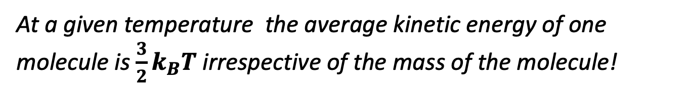
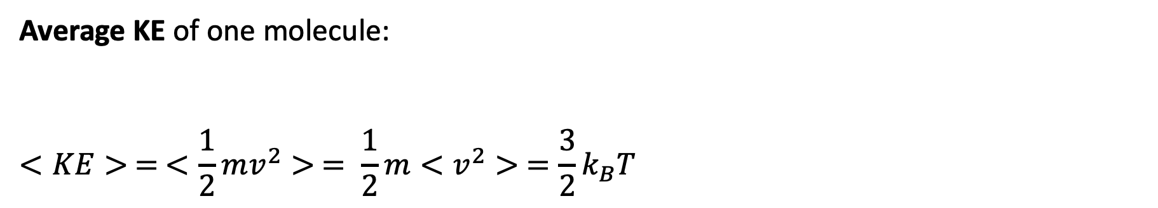
Average kinetic energy
Average KE of one molecule:
$$<KE> = <\frac{1}{2}mv^{2}> = \frac{1}{2}m<v^{2}> =\frac{3}{2}k_{B}T$$
At a given temperature the average kinetic energy of one molecule is $\frac{3}{2}k_{B}T$ irrespective of the mass of the molecule!

Slide 7
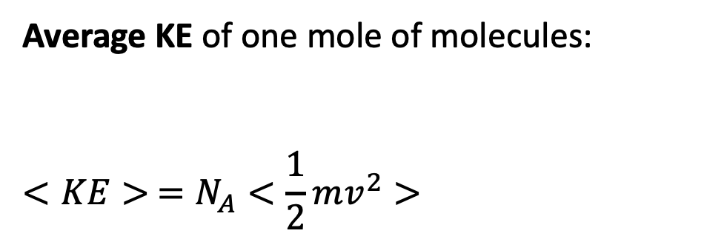
Average kinetic energy
Average KE of one mole of molecules:
$$<KE> =N_{A}<\frac{1}{2}mv^{2}>$$
Pretend there are 6.02 x 10²³ of these

Slide 8
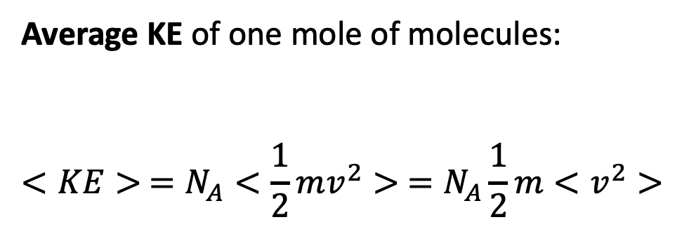
Average kinetic energy
Average KE of one mole of molecules:
$$<KE> =N_{A}<\frac{1}{2}mv^{2}> =N_{A}\frac{1}{2}m<v^{2}>$$
Pretend there are 6.02 x 10²³ of these

Slide 9
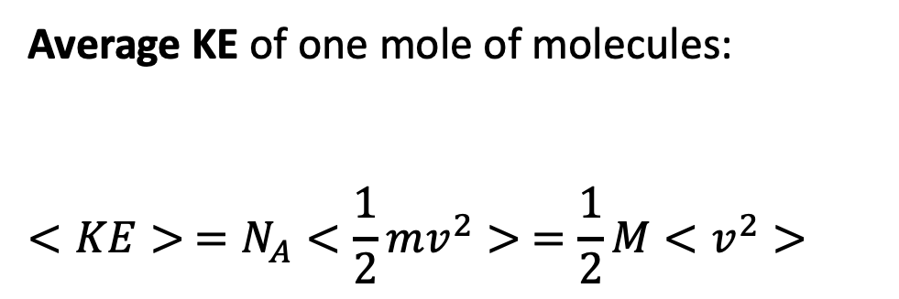
Average kinetic energy
Average KE of one mole of molecules:
$$<KE> =N_{A}<\frac{1}{2}mv^{2}> =\frac{1}{2}M<v^{2}>$$
Pretend there are 6.02 x 10²³ of these

Slide 10
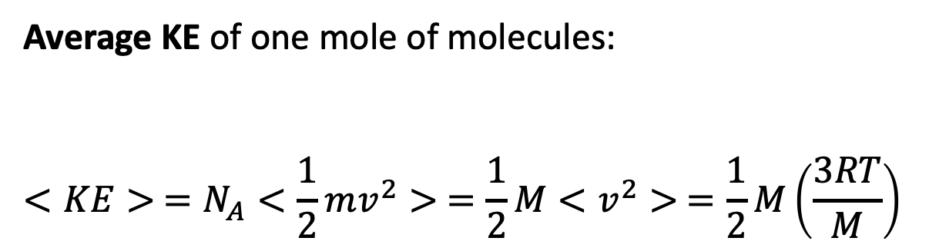
Average kinetic energy
Average KE of one mole of molecules:
$$<KE> =N_{A}<\frac{1}{2}mv^{2}> =\frac{1}{2}M<v^{2}> =\frac{1}{2}M\left(\frac{3RT}{M}\right)$$
Pretend there are 6.02 x 10²³ of these

Slide 11
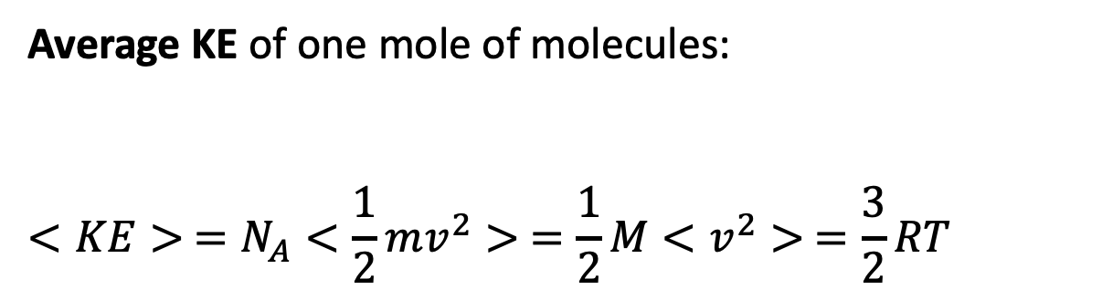
Average kinetic energy
Average KE of one mole of molecules:
$$<KE> =N_{A}<\frac{1}{2}mv^{2}> =\frac{1}{2}M<v^{2}> =\frac{3}{2}RT$$
Pretend there are 6.02 x 10²³ of these

Slide 12
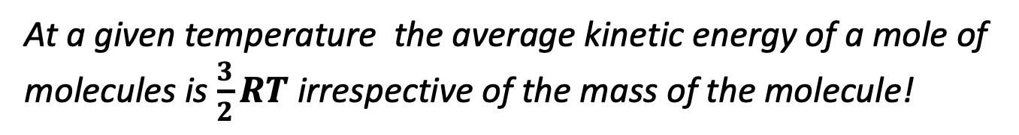
Average kinetic energy
Average KE of one mole of molecules:
$$<KE> =N_{A}<\frac{1}{2}mv^{2}> =\frac{1}{2}M<v^{2}> =\frac{3}{2}RT$$
Pretend there are 6.02 x 10²³ of these
At a given temperature the average kinetic energy of a mole of molecules is $\frac{3}{2}RT$ irrespective of the mass of the molecule!

Slide 13
Remaining work today
Solve the integrals $<v>$ , $<v^{2}>$ , and $<v^{3}>$ analytically (integral tables)
Compare these analytical results to numerical one we got before (Python)

Slide 14
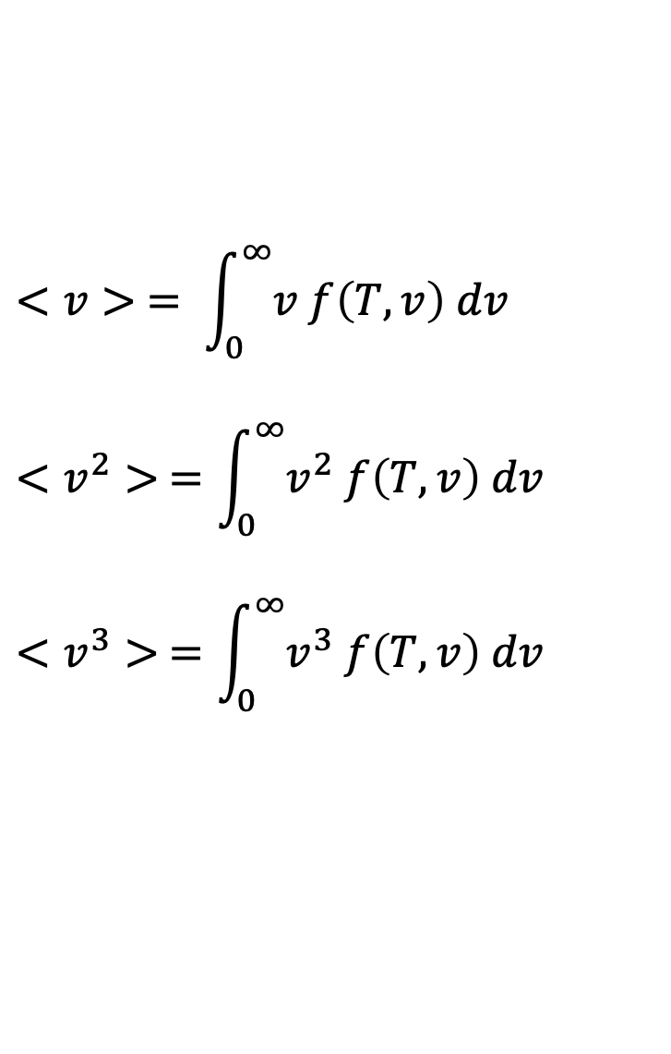
Integral tables
$$<v> = \int_{0}^{∞}{v f\left(T,v\right) dv}$$
$$<v^{2}> =\int_{0}^{∞}{v^{2} f\left(T,v\right) dv}$$
$$<v^{3}> =\int_{0}^{∞}{v^{3} f\left(T,v\right) dv}$$

Slide 15
Integral tables
$$<v> = \int_{0}^{∞}{v f\left(T,v\right) dv}$$
$$<v^{2}> =\int_{0}^{∞}{v^{2} f\left(T,v\right) dv}$$
$$<v^{3}> =\int_{0}^{∞}{v^{3} f\left(T,v\right) dv}$$

